Slide 1
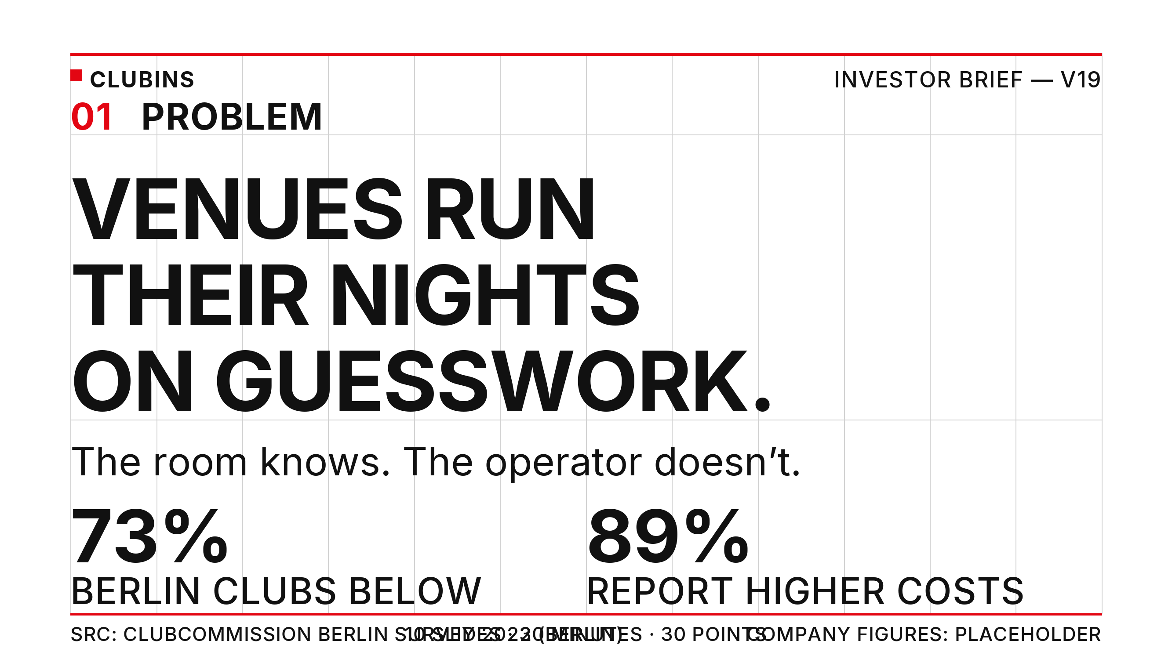
Notes:
Problem. Clubins gives venue staff live visibility of sound levels, occupancy and environmental conditions. The 73%/89% figures are sourced: Clubcommission Berlin survey, 2023 (via miz.org) - survey data, Berlin-specific. No national complaint/closure statistic exists; noise is framed as documented displacement risk.

Slide 2
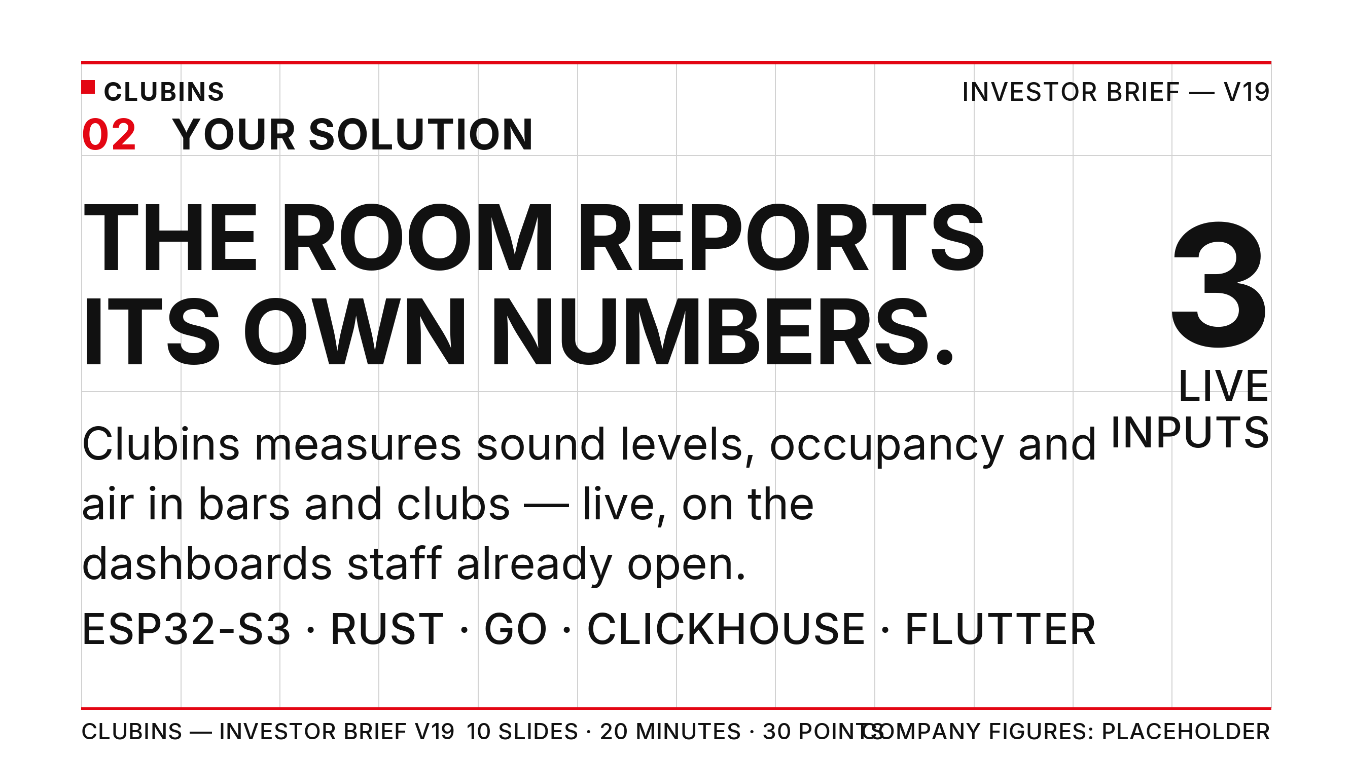
Notes:
Your Solution. Product truth: ESP32-S3 sensors with Rust firmware, Go ingestion, ClickHouse, Flutter dashboards (web/Android/iOS). Pre-launch; recruiting pilot venues.

Slide 3
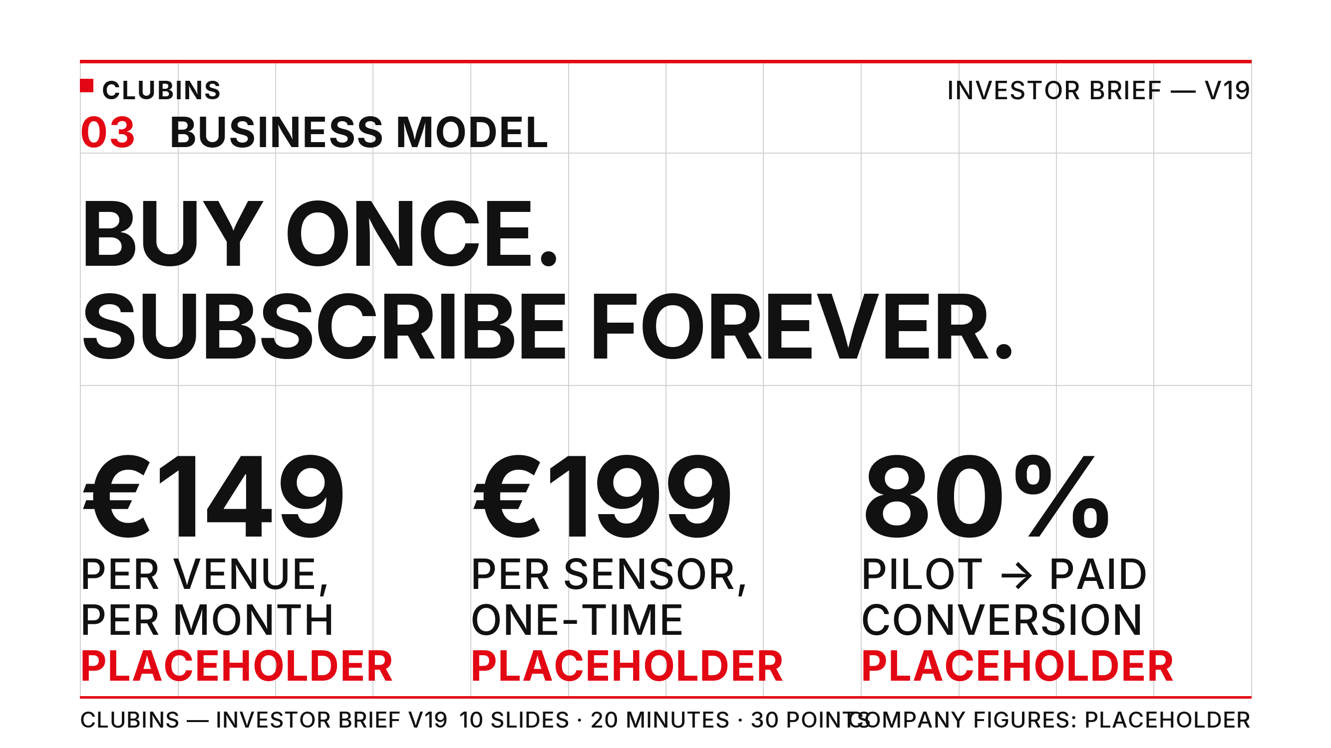
Notes:
Business Model. All figures PLACEHOLDER from the Placeholder Metrics Register (wb_cg3xEK66): EUR 149 per venue/month, EUR 199 per sensor, 80% pilot-to-paid conversion target.

Slide 4
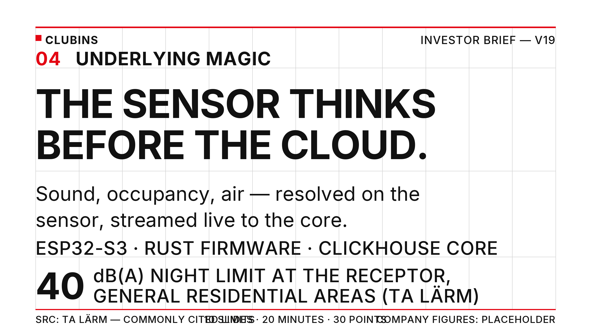
Notes:
Underlying Magic. Edge inference on-device; TA Larm night immission limits commonly cited at 40 dB(A) at the receptor in general residential areas - verify against official TA Larm Table 1 before any external use. Limits are at the receptor, not inside the club.

Slide 5
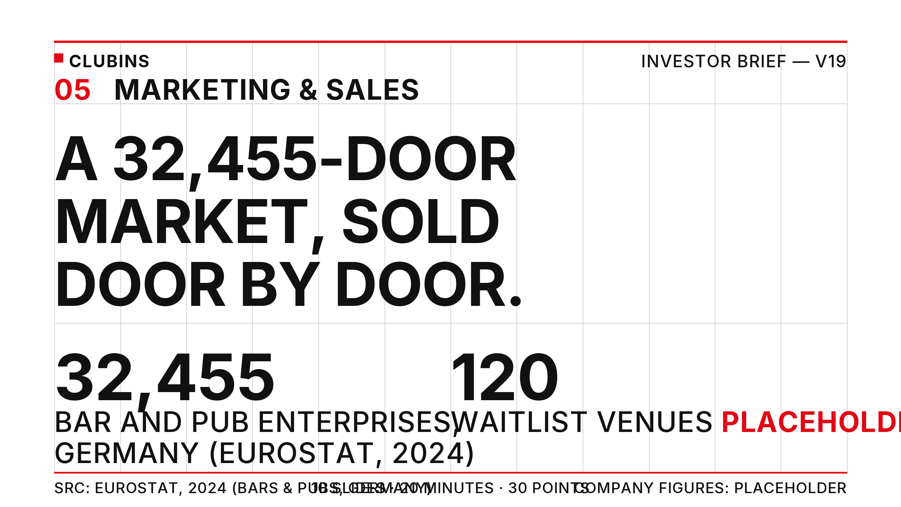
Notes:
Marketing & Sales. Market size sourced: 32,455 bar and pub enterprises in Germany (Eurostat NACE I5630, 2024). Do not sum with live-music venue figures - classifications overlap. Waitlist is a PLACEHOLDER register metric.

Slide 6
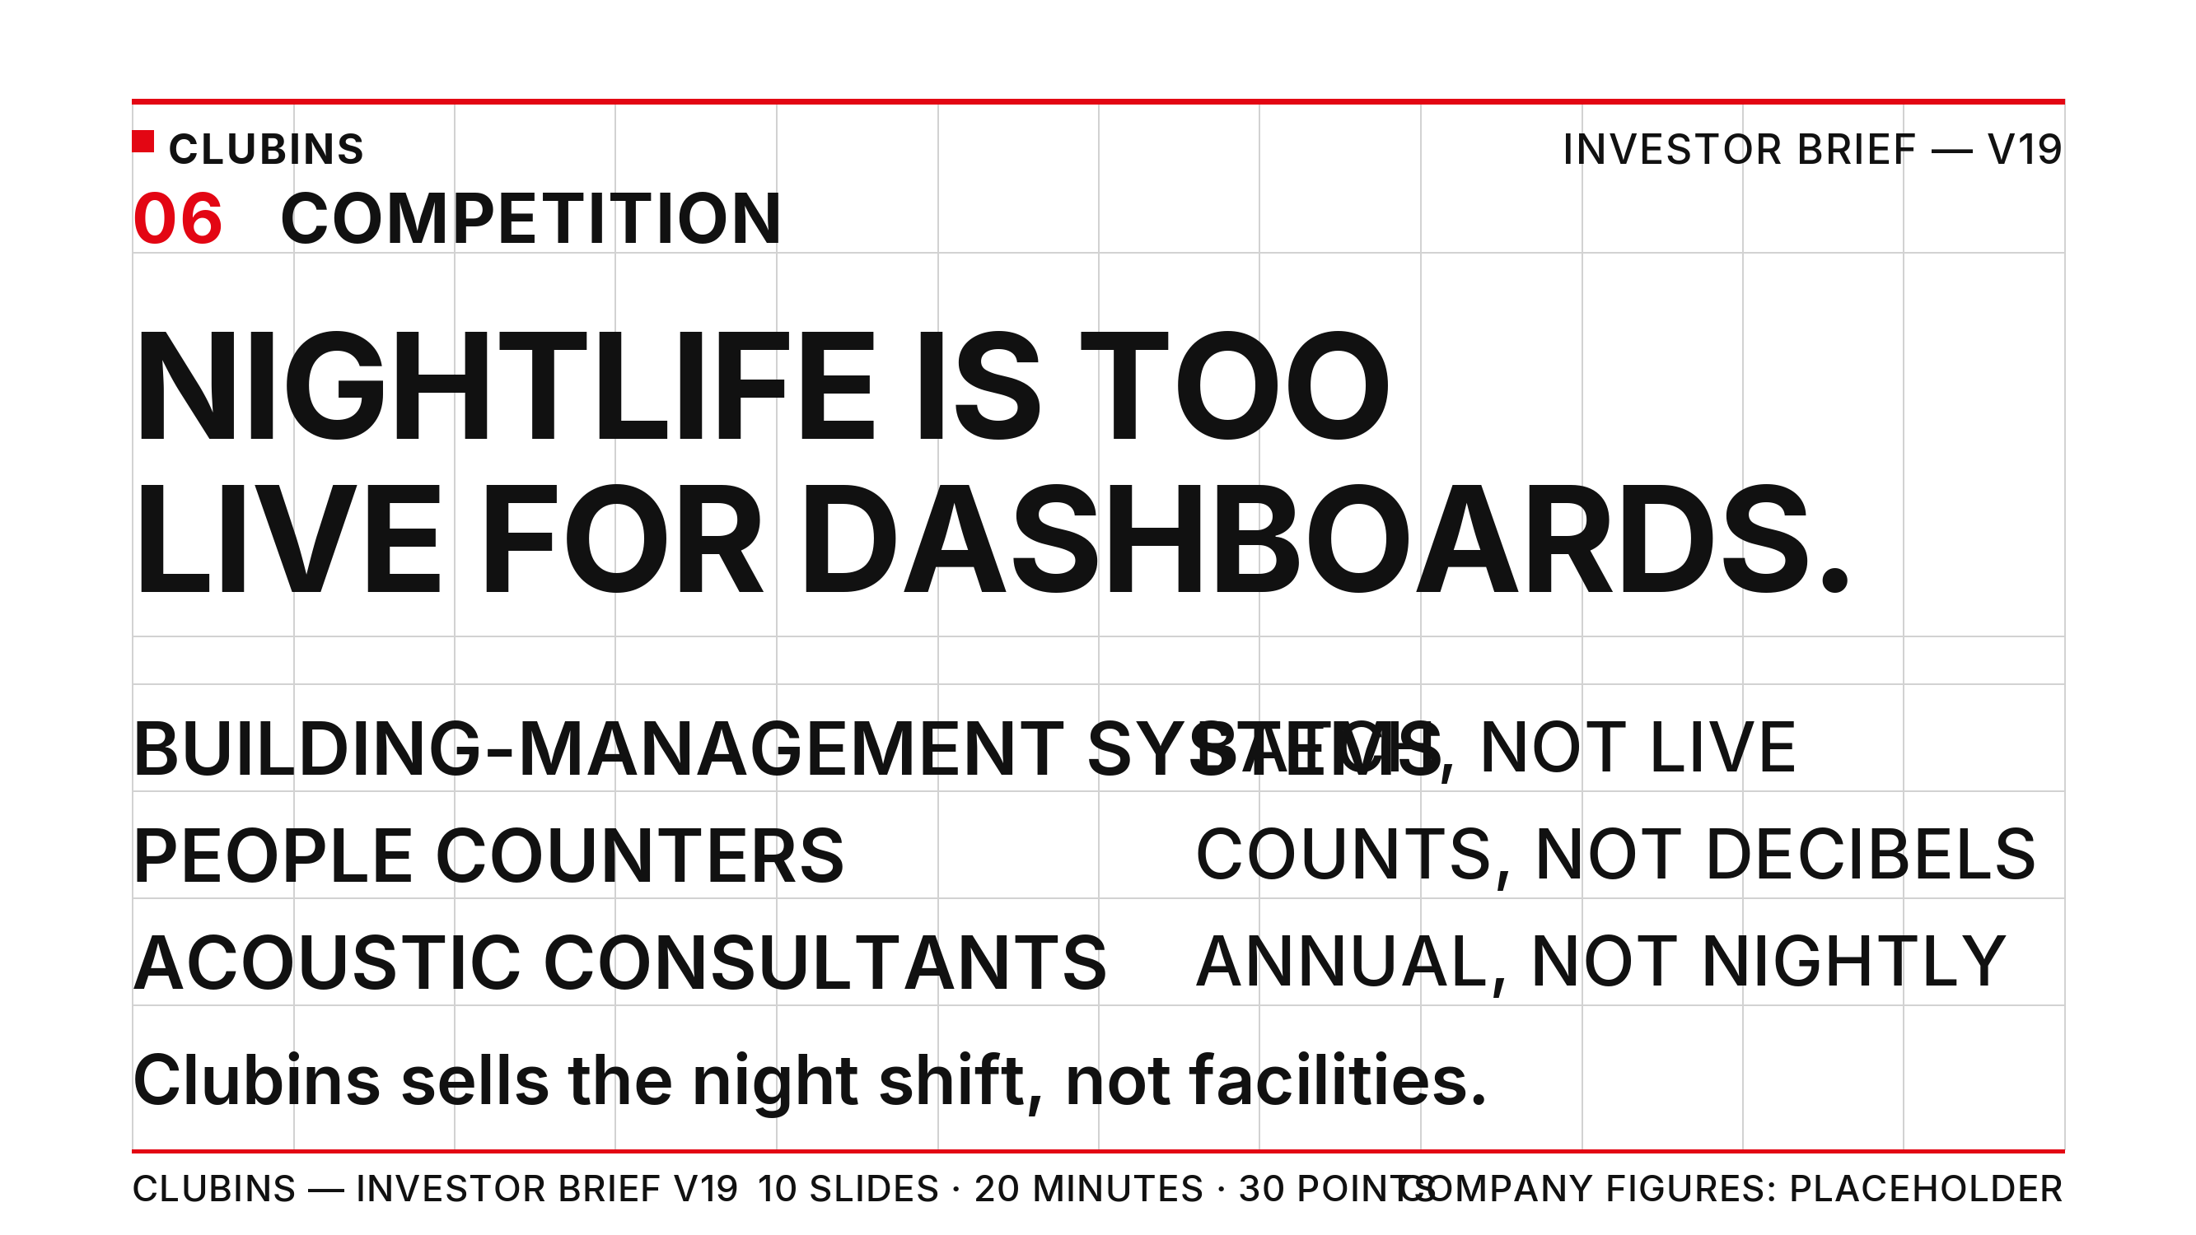
Notes:
Competition. Positioning against building-management systems, people counters and acoustic consultants. No competitor numbers invented.

Slide 7

Notes:
Team. Patrick Hau mann (Munich - founder, product & platform) and Swiftb0y (Berlin - engineering). Team size and founding year are PLACEHOLDER register metrics.

Slide 8
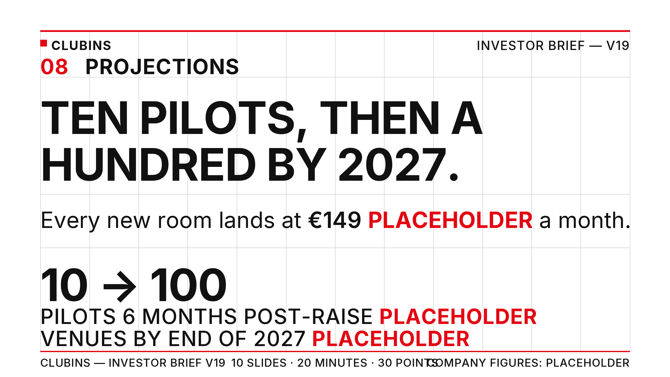
Notes:
Projections. PLACEHOLDER register metrics: 10 pilot venues within 6 months post-raise; 100 venues by end of 2027; EUR 149 per venue per month.

Slide 9
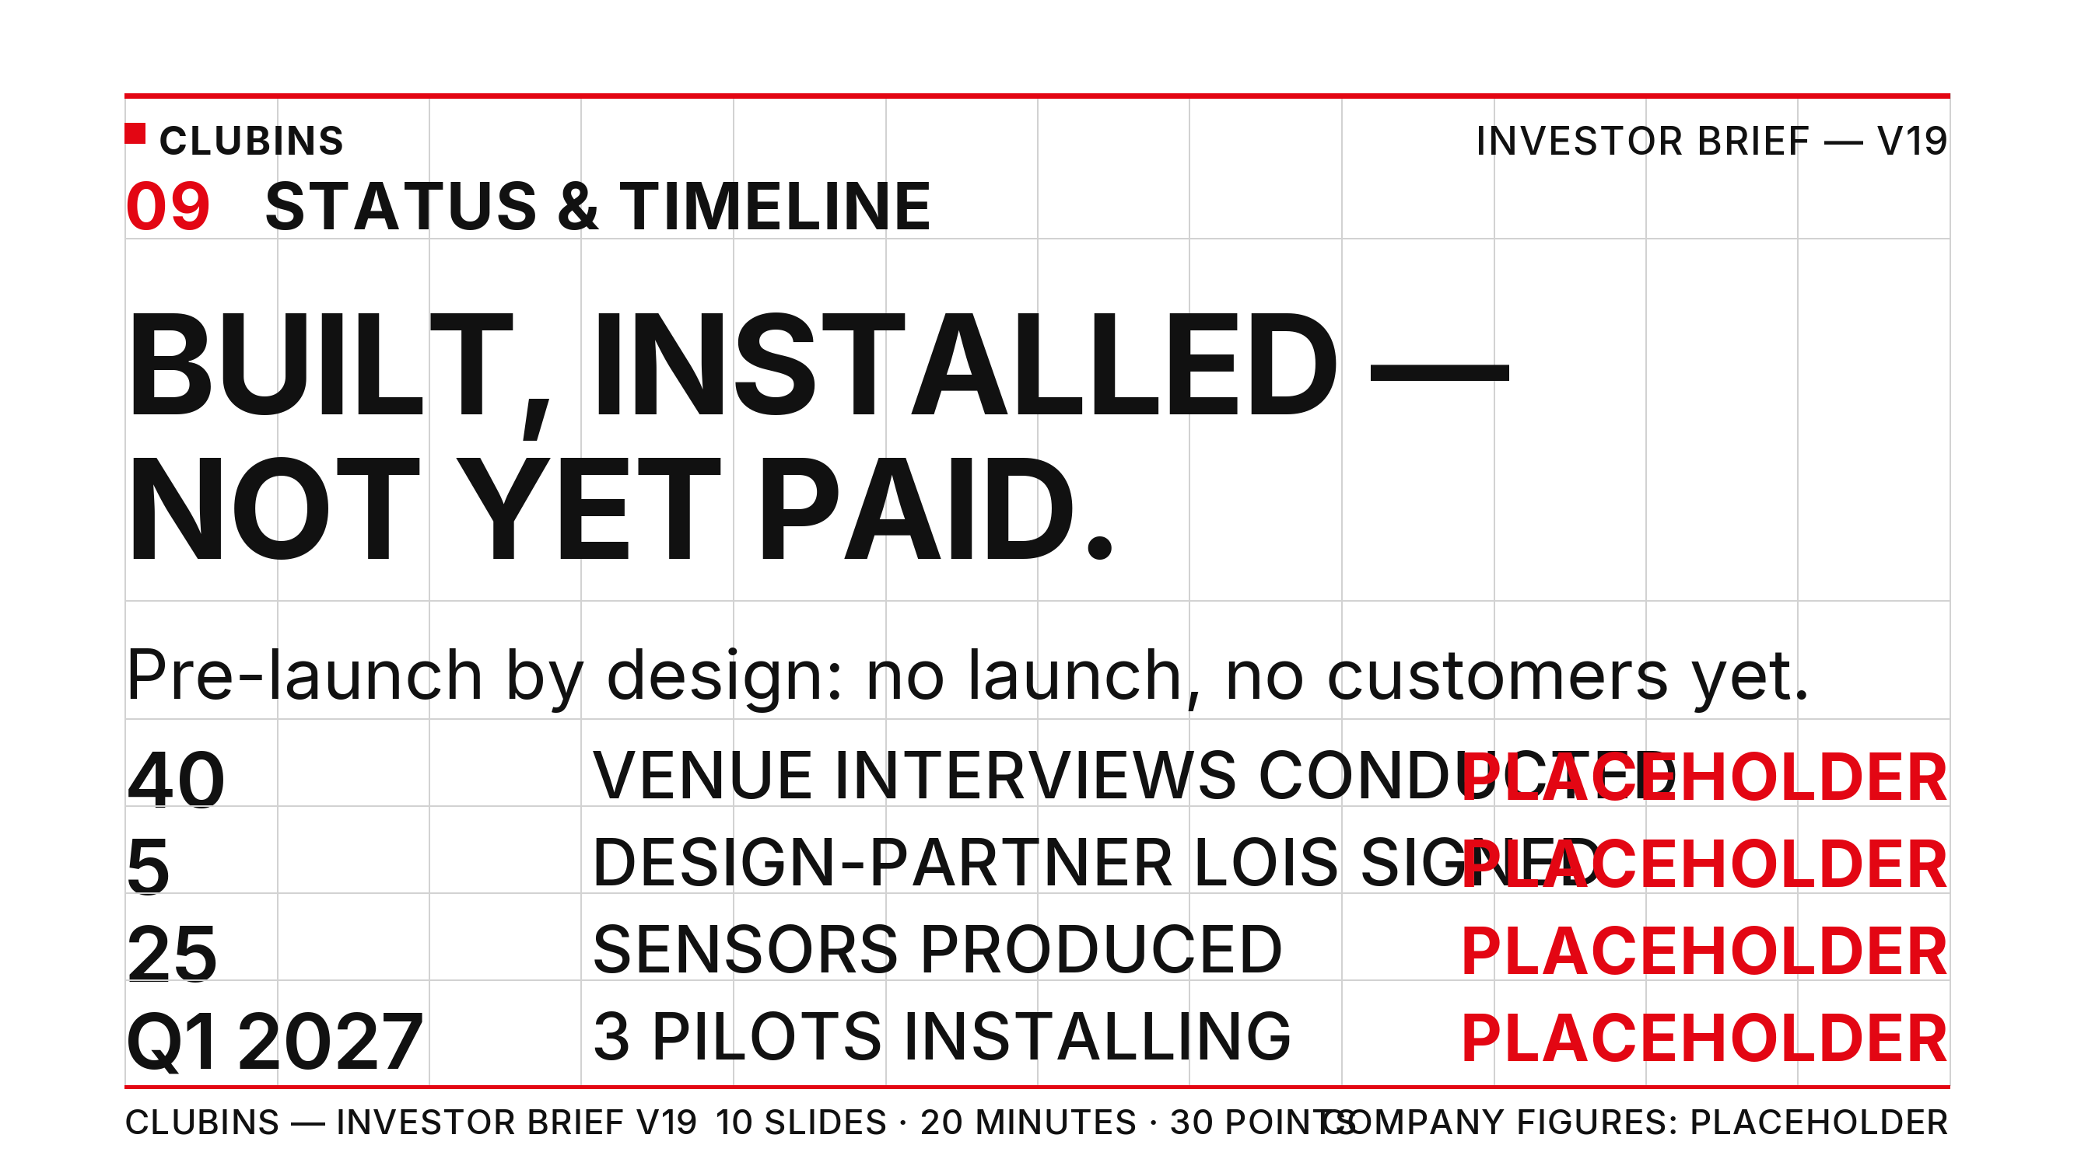
Notes:
Status & Timeline. PLACEHOLDER register metrics: 40 venue interviews, 5 design-partner LOIs, 25 sensors produced, 3 pilot venues installing Q1 2027. Pre-launch: no public launch and no paying customers - never claim otherwise.

Slide 10
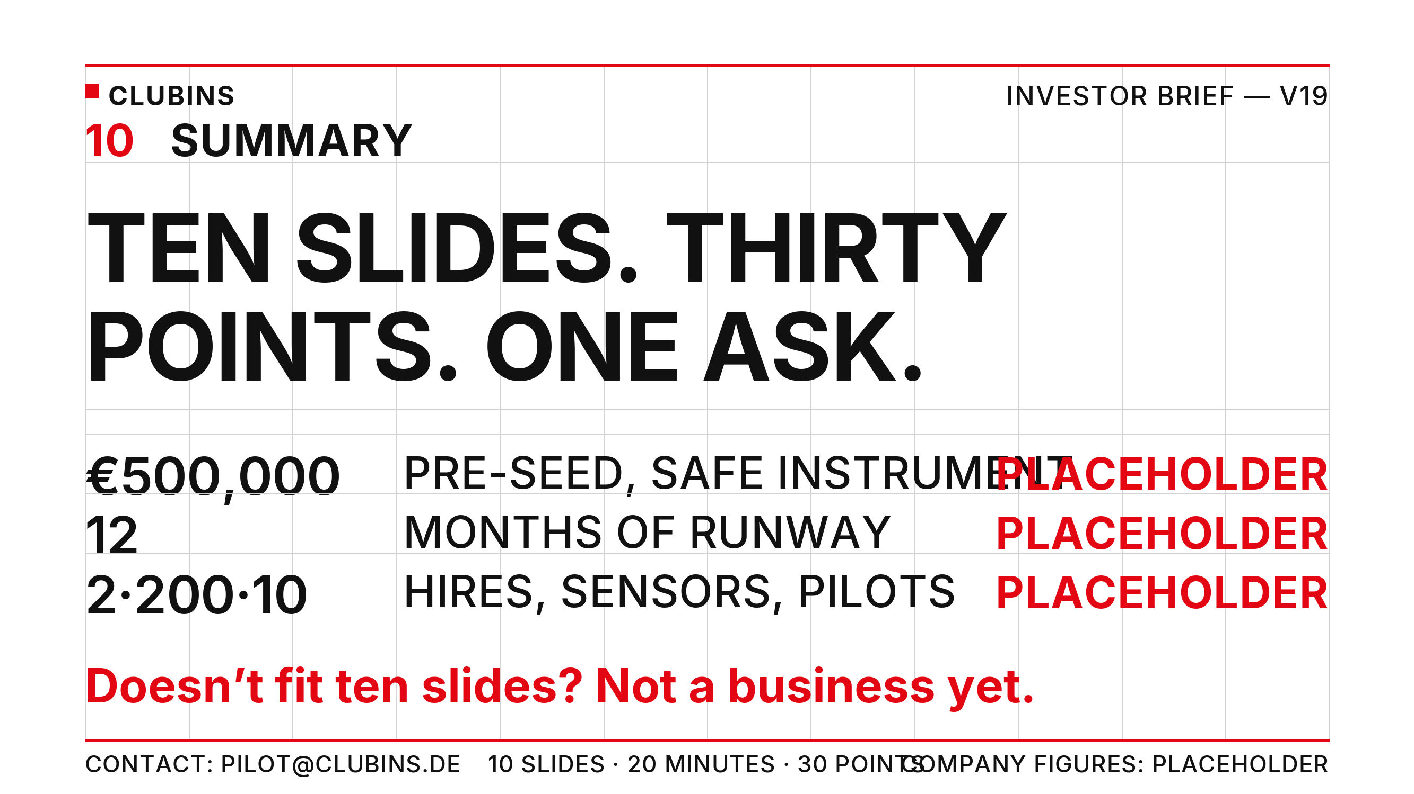
Notes:
APPENDIX NOTE - doctrine source: Guy Kawasaki, 'The 10/20/30 Rule of PowerPoint' (December 30, 2005), https://guykawasaki.com/the_102030_rule/ - ten slides, twenty minutes, no font smaller than thirty points. The discipline is the diligence signal: if it does not fit ten slides, it is not a business yet. All company figures are PLACEHOLDER values from the Placeholder Metrics Register (wb_cg3xEK66 / sh_vpK5zAbf); market and regulation claims are quoted and qualified from the sourced Market & Regulation Facts document. Contact: pilot@clubins.de

